Slide 1
Project Title: Malt
Project Code: CS6P05NP
Name: Manish Dhamala
London Met ID: 22069006
Date: 5 September,2024

Slide 2
Introduction
Malt is a web application designed for online food ordering.
In today’s fast-paced digital world, traditional food ordering methods are being replaced by user-friendly web apps. However, many existing solutions lack customization and simplicity. Malt aims to address these gaps by providing an easy-to-use platform that benefits both customers and restaurants, tailored specifically to meet the needs of users in Nepal.

Slide 3
Problem Statement
Challenges Faced in the Nepalese market:
  Limited apps for online food ordering.
  Reliance on unreliable phone calls/messages.
  Missed revenue opportunities due to lack of online presence.
  Inefficient order management caused by human errors.
  Difficulty managing online operations due to complex interfaces.

Slide 4
Project as a Solution
Malt will provide the following solutions:
  Fill the market gap with a dedicated online food ordering platform.
  Simplify the ordering process, eliminating the need for phone calls.
  Boost restaurant revenue with a strong online presence.
  Enhance order accuracy and efficiency with a digital platform.
  Provide a simple, user-friendly interface for easy online management.

Slide 5
Aims and Objectives
Aim:
Develop a user-friendly web application, Malt that simplifies online food ordering for customers and offers an efficient platform for restaurants to boost their online presence and revenue.
Objectives:
Design a user-friendly interface for easy food browsing, and ordering.
Build a secure platform for managing orders, payments, and customer data.
Provide a simple dashboard for restaurants to manage orders.
Implement real-time order tracking for customers.
Allow restaurants to customize menus and prices.

Slide 6
Expected Outcomes and Deliverables
Expected Outcomes:
  Enhanced Accessibility: Easy online food ordering in Nepal.
  Increased Revenue: Broader online reach for restaurants.
  Improved Management: Fewer order errors, efficient operations.
  User-Friendly: Simple interface for all users.
Deliverables:
  Web App: Fully functional Malt with key features.
  Dashboard: Easy-to-use restaurant management tool.
  Documentation: Detailed development report.
  Source Code: Complete application code.

Slide 7
Methodology
Selected Methodology: Incremental Model
The Incremental Model divides the project into smaller, manageable parts. Each increment goes through requirement gathering, design, development, testing, and implementation, gradually adding functionality until the final product is complete.
Why Incremental?
Allows for adjustments and additions in each increment.
Essential features are completed first, with new functionalities added in iterations.

Slide 8
Resource Required
Software:
  Frontend: React for UI development.
  Backend: Spring Boot for business logic and APIs.
  Database: PostgreSQL for data management.
  Documentation: MS Word for project reports
  Development Environments:
    IntelliJ IDEA for backend development.
    Visual Studio Code for frontend development.
  Version Control: Git and GitHub for version control.
  Diagrams: draw.io for creating diagrams.
  Design Tools: Figma or Canva for UI/UX design.
Publications and References:
  Access to research papers on React, Spring Boot, and database management.
  Sample datasets for testing the application.

Slide 9
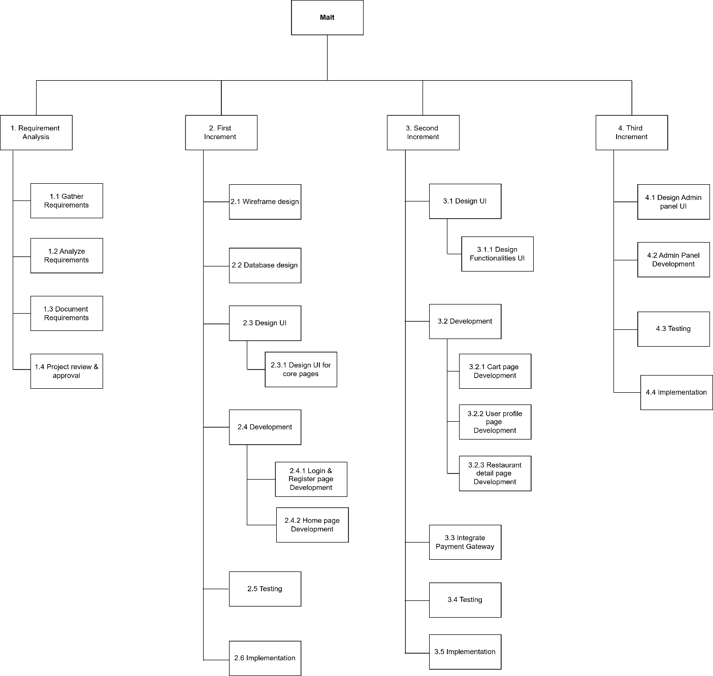
Work Breakdown Structure

Slide 10
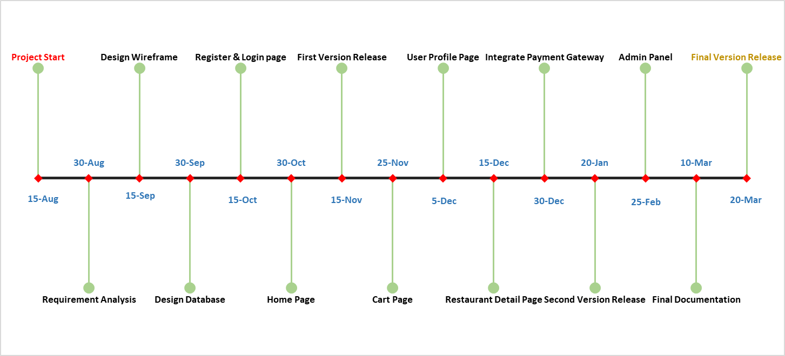
Milestone Listing

Slide 11
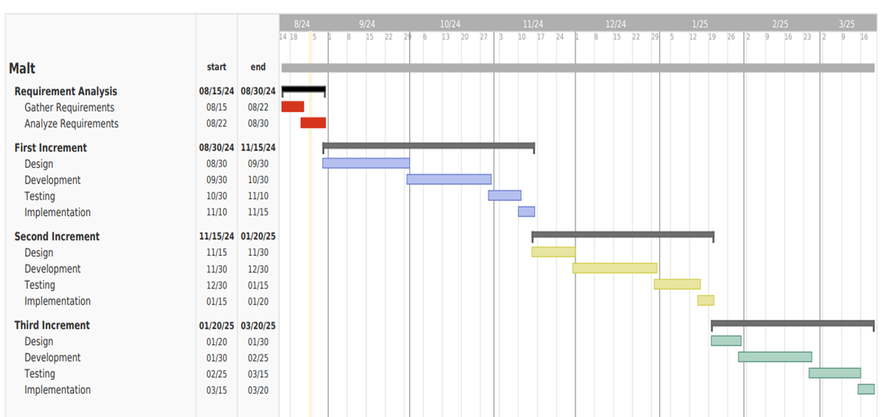
Gantt Chart

Slide 12
Thank You!

